Slide 1
Sample and Hold and Block Diagram Analysis
Sample and hold circuit
  Mathematical representation
  Zero-order hold
  First-order hold
Spectrum of a sampled signal
  Sampling theorem
  Frequency response of ZOH (and FOH)
Block diagram analysis of sampled-data systems
  Modeling digital control systems using only Laplace transforms

Slide 2


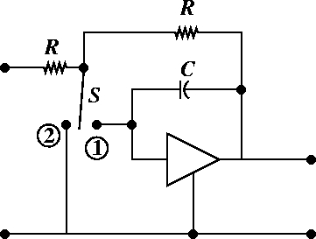
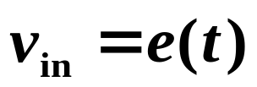
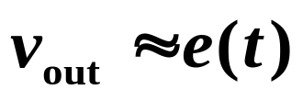
Sample and Hold Circuit (SHC)
SHC
A/D
When switch is in position 1 , circuit is a low pass filter.

Slide 3
When switch is in position 2 , the capacitor holds the output voltage equal to the input voltage long enough for the A/D to convert the signal to a digital number to feed to the digital computer or microprocessor.

Slide 4
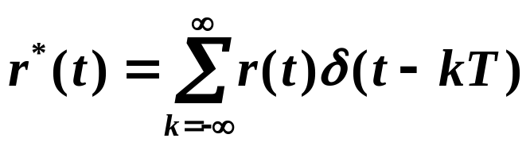

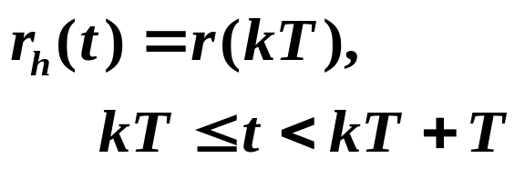

Mathematical Representation for Sample and Hold
Sampling operation represented as impulse modulation
Hold operation represented as a linear filter
ZOH

Slide 5
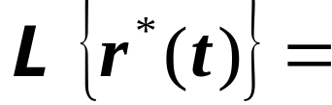
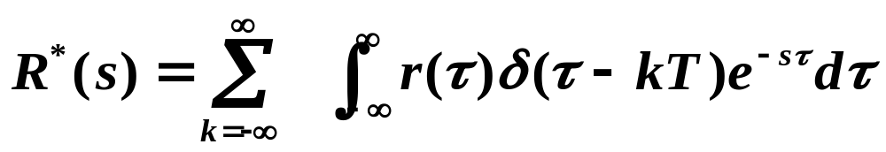
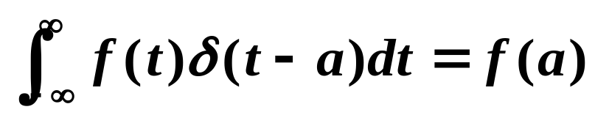
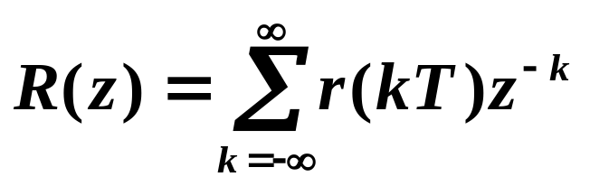
Sifting property of impulse function:
Note similarity with Z-transform.

Slide 6


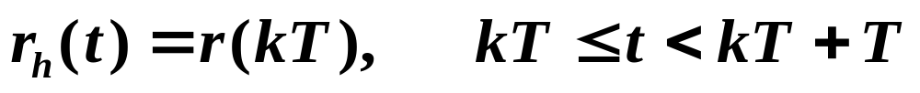
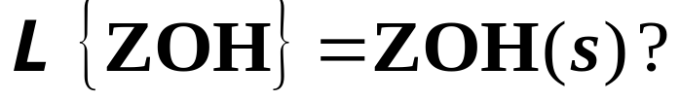
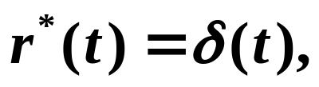
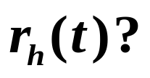
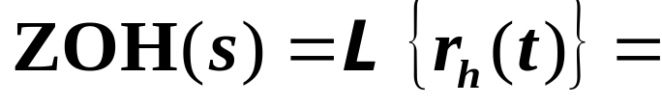
Assuming a zero-order hold:
ZOH
What is
For
what is

Slide 7


First-Order Hold
Extrapolates data between sampling periods by a first-order polynomial
Unit impulse response
FOH

Slide 8
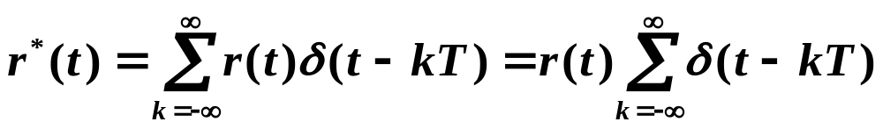
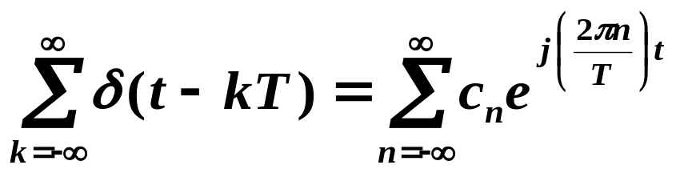
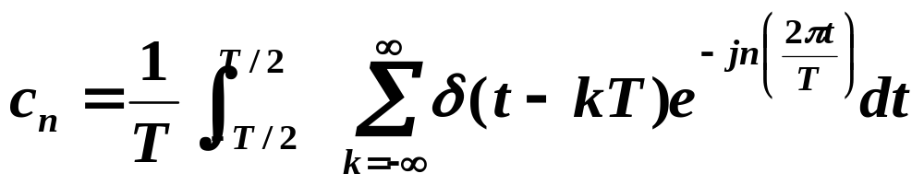
Spectrum of a Sampled Signal
Can we reconstruct r(t) from r*(t) exactly?
Can represent impulse train using a Fourier series:
Fourier coefficients are found by integral over one period:

Slide 9
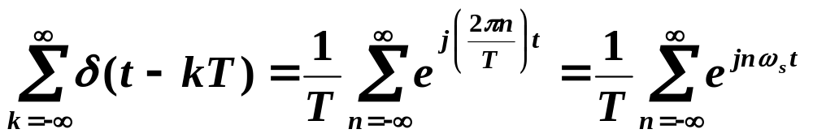


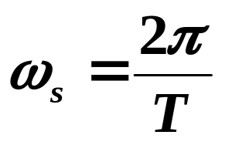
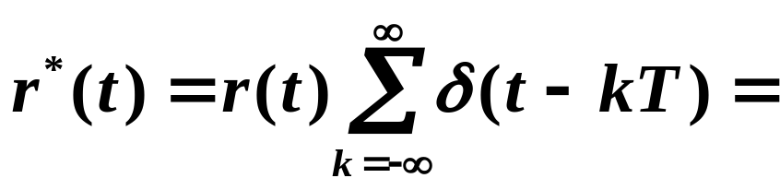
And we can write this as:
Sampling interval or sampling period (sec)
Sampling rate or sampling frequency (Hz)
Sampling frequency in radians/s
So

Slide 10
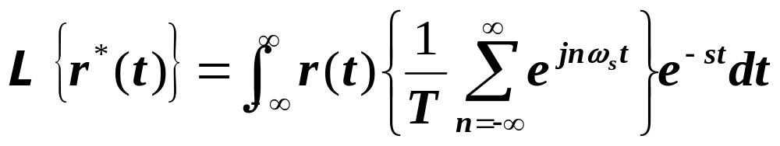
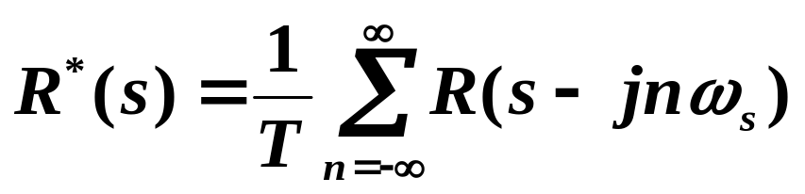
Now,
Integrate term by term:
See Figure 5.4 of text.
Aliasing occurs when:
In the frequency domain, components of spectrum of sampled signal overlap. See Figure 5.4 of text.
In time domain, 2 different signals appear the same after sampling. See Figure 5.5 of text.

Slide 11
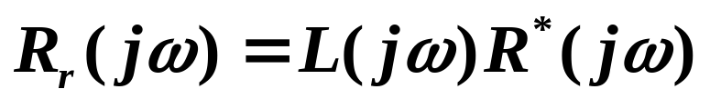


Sampling Theorem
If the sampling frequency is at least twice the highest frequency in the signal, then it is possible to recover the original signal exactly from its samples.
Low pass filter the sampled signal spectrum to obtain the original signal spectrum:
L(jω)
Ideal low-pass filter

Slide 12
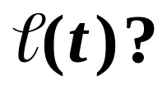
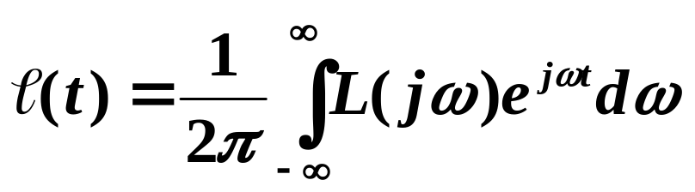
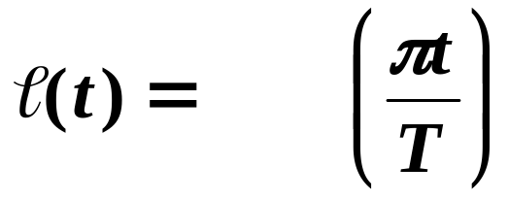
What is
sinc

Slide 13
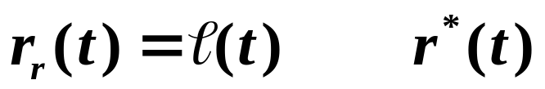
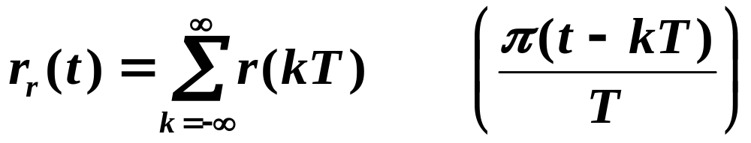
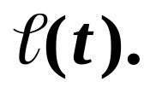
*
sinc
See Figure 5.7 of text for plot of
Do you see any practical problem with this

Slide 14
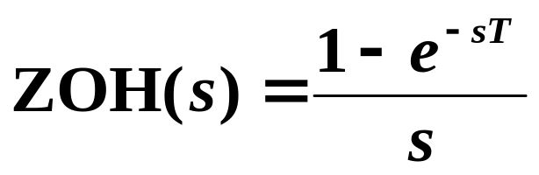
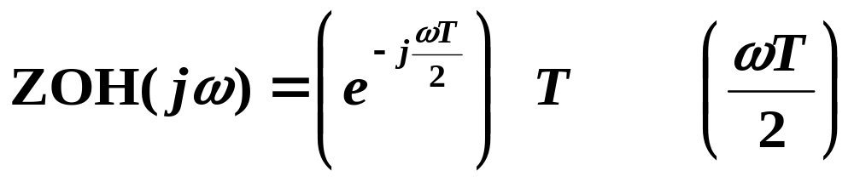
Frequency Response of ZOH
sinc

Slide 15
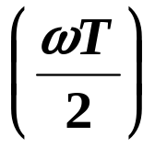
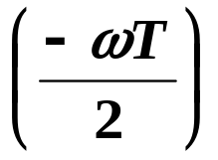
sinc
Compared to the ideal low-pass filter:
  Magnitude multiplied by
  Phase shift of
sinc
See text Fig. 5.8 for freq response plots for ZOH & FOH filters.

Slide 16


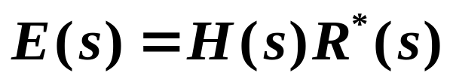
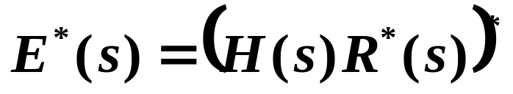
Block Diagram Analysis of Sampled-Data Systems
How do we perform block diagram analysis when some of the signals are sampled?
  Fairly straightforward . . . but a few difficulties can sometimes arise . . .
H(s)

Slide 17
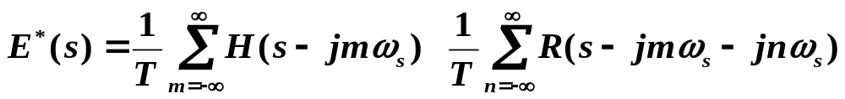
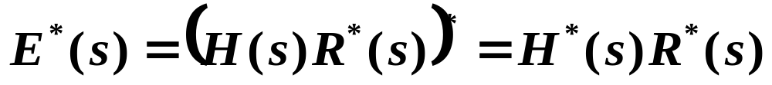
  When sampling a product of a periodic transform (of a sampled signal) and a non-periodic one, the periodic transform gets factored out.

Slide 18
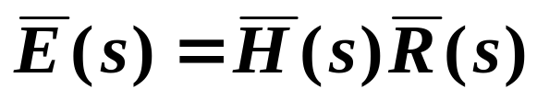
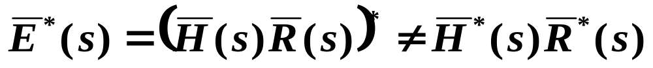
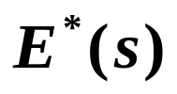
  But only periodic transforms get factored out. If
then
  If we have the Laplace transform of an impulse-modulated continuous-time sampled signal , the Z-transform of the discrete-time sampled signal is

Slide 19








Modeling Digital Control Systems
Using Only Laplace Transforms
Σ
D/A

Slide 20
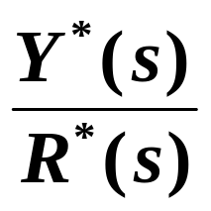
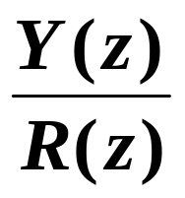
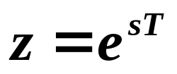

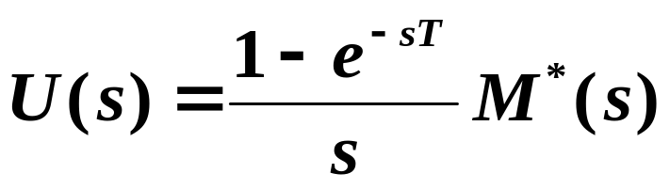
  In digital control design, we often want to convert everything to the Z-domain.
  Working with this “continuous-time” model of a digital control system, we can compute the transfer function:
    In block diagram:
and then use the map to get

Slide 21
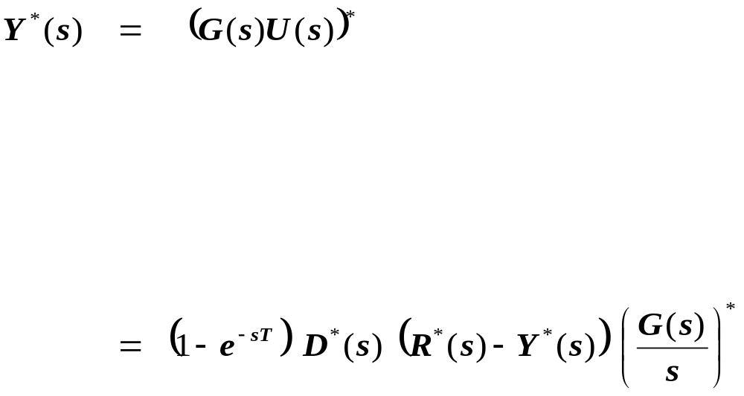

Slide 22
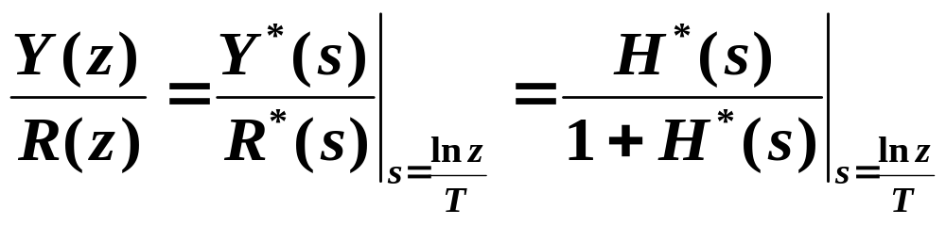
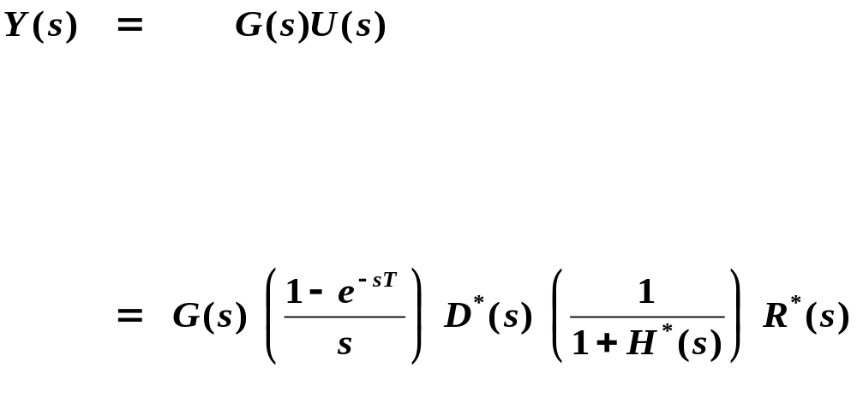
Now
Determining the inverse Laplace transform of Y(s) allows you
to see how y(t) behaves between samples.

